Slide 1
Example

Slide 2
A* Algorithm
Section 5.2 of Chapter Solving Problems by Searching part of syllabus for Mid 1
An example presented here to enable your reading the textbook

Slide 3
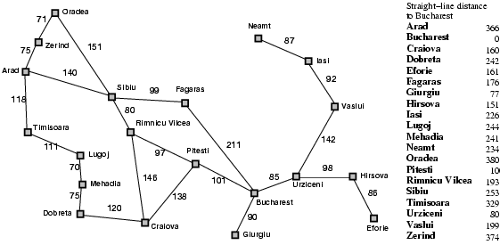
Romania with step costs in km

Slide 4

A* search example
Open List:
Arad
We start with our initial state Arad. We take a node and add it to the open list. Since it’s the only thing on open list, we expand the node.
Open list is sorts the nodes inside of it according to their g()+h() score.

Slide 5
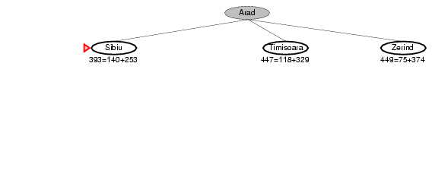
A* search example
Open List:
Sibiu
Timisoara
Zerind
We add the three nodes we found to the open list.
We sort them according to the g()+h() calculation.

Slide 6
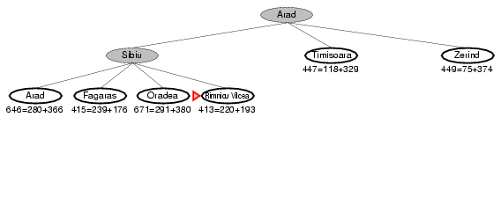
A* search example
Open List:
Rimricu Vicea
Fagaras
Timisoara
Zerind
Arad
Oradea
We’ve been to Arad before. Don’t list it again on the open list.
When we expand Sibiu, we run into Arad again. But we’ve already expanded this node once; so, we don’t add it to the open list again.

Slide 7
A* search example
Open List:
Rimricu Vicea
Fagaras
Timisoara
Zerind
Oradea
We see that Rimricu Vicea is at the top of the open list; so, it’s the next node we will expand.

Slide 8
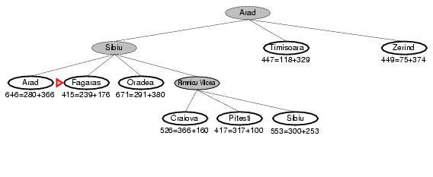
A* search example
Open List:
Fagaras
Pitesti
Timisoara
Zerind
Craiova
Sibiu
Oradea
When we expand Rimricu Vincea, we run into Sibiu again.
But we’ve already expanded this node once; so, we don’t add it to the open list again.

Slide 9
A* search example
Open List:
Fagaras
Pitesti
Timisoara
Zerind
Craiova
Oradea
Fagaras will be the next node we should expand – it’s at the top of the sorted open list.

Slide 10
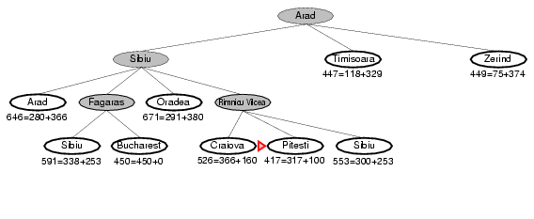
A* search example
Open List:
Pitesti
Timisoara
Zerind
Bucharest
Craiova
Sibiu
Oradea
When we expand Fagaras, we find Sibiu again. We don’t add it to the open list.
We also find Bucharest, but we’re not done. The algorithm doesn’t end until we “expand” the goal node – it has to be at the top of the open list.

Slide 11
A* search example
Open List:
Pitesti
Timisoara
Zerind
Bucharest
Craiova
Oradea
It looks like Pitesti is the next node we should expand.

Slide 12
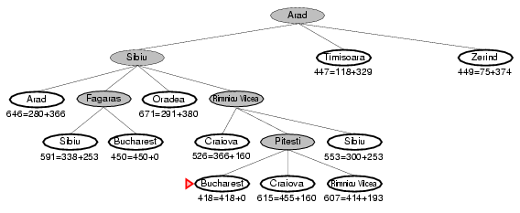
A* search example
Open List:
Bucharest
Timisoara
Zerind
Craiova
Rimricu Vicea
Oradea
We just found a better value for Bucharest; so, it got moved higher in the list. We also found a worse value for Craiova – we just ignore this.
And of course, we ran into Rimricu Vicea again. Since it’s already been expanded once, we don’t re-add it to the Open List.

Slide 13
A* search example
Open List:
Bucharest
Timisoara
Zerind
Craiova
Oradea
Now it looks like Bucharest is at the top of the open list…

Slide 14
A* search example
Open List:
Bucharest
Timisoara
Zerind
Craiova
Oradea
Now we “expand” the node for Bucharest.
We’re done! (And we know the path that we’ve found is optimal.)

Slide 15
Memory bounded heuristics
Section 5.3 of Chapter Solving Problems by Searching is part of syllabus for exam
SMA* example presented here to help you understand the material better

Slide 16
Memory bounded heuristic search
Iterative deepening A* (IDA*)
Similar to iterative deepening algorithm
f-cost (g+h) used as cutoff rather than depth
At each iteration, cutoff value is smallest f-cost of any node that exceeded the cutoff on previous iteration
Recursive best-first search (RBFS)
Similar to recursive depth first search in structure
Uses f-limit variables to keep track of f-values
Is an optimal algorithm if h(n) is admissible
Space complexity linear in the depth of the deepest optimal solution
IDA* and RBFS suffer from using too little memory
How to use all memory available ?

Slide 17
SMA* Example
A
2
4
S
B
2
G
3
5
C
1
 | S | A | B | C | G
Heuristic | 3 | 0 | 2 | 1 | 0

Slide 18
SMA* Example
0
A
0
3
4
2
S
3
0
3
2
S
3
B
2
G
1
5
C
1
Perform SMA* with memory = 3 nodes

Slide 19
SMA* Example
0
A
0
3
4
2
S
3
0
3
2
S
3
B
2
G
4
0
1
A
4
5
C
1
Generate children

Slide 20
SMA* Example
0
A
0
3
4
2
S
3
0
3
2
S
3
B
2
G
4
0
1
A
4
5
C
1
Generate children

Slide 21
SMA* Example
0
A
0
3
4
2
S
3
0
3
2
S
3
B
2
G
1
4
0
A
4
3
2
B
5
5
C
1
Generate children

Slide 22
SMA* Example
0
A
0
3
4
2
S
(5)
3
0
3
2
S
3
B
2
G
1
4
0
A
4
5
1
C
6
5
C
1
Memory Full
Forget B
3
2
B
5

Slide 23
SMA* Example
0
A
0
3
4
2
S
(5)
4
0
3
2
S
3
B
2
G
1
4
0
A
4
5
1
C
6
5
C
1
All children explored
Adjust f-values

Slide 24
SMA* Example
0
A
0
3
4
2
S
(5)
4
0
3
2
S
3
B
2
G
1
4
0
A
4
5
1
C
6
5
C
1
Memory Full
Remove C
6
0
G
6

Slide 25
SMA* Example
0
A
0
3
4
2
S
(5)
4
0
3
2
S
3
B
2
G
1
4
0
A
6
5
C
1
All children explored
Adjust f-values
6
0
G
6

Slide 26
SMA* Example
0
A
0
3
4
2
S
(5)
4 5
0
3
2
S
3
B
2
G
1
4
0
A
6
5
C
1
All children explored
Adjust f-values
6
0
G
6

Slide 27
SMA* Example
0
A
0
3
4
2
S
5
0
3
2
S
3
B
2
G
1
4
0
A
(6)
6
3
2
B
5
5
C
1
Memory Full
Remove G
6
0
G
6

Slide 28
SMA* Example
0
A
0
3
4
2
S
(6)
5
0
3
2
S
3
B
2
G
1
4
0
A
(6)
6
5
1
5
C
1
C
6
Memory Full
Remove A
3
2
B
5

Slide 29
SMA* Example
0
A
0
3
4
2
S
(6)
5
0
3
2
S
3
B
2
G
1
3
2
B
5
5
1
C
6
5
C
1
Memory Full
Remove C
3
2
G
5

Slide 30
Question
Current Rule: Replace new node with the leaf with worst f-value ?
New Rule: Why not replace only if f-value of new leaf is better than the leaf that it was replacing ?
Example in next slide is only for illustration of this counter example.
Please follow the notation used in the SMA* example worked in earlier slides for exam purposes

Slide 31
Simple Memory-bounded A* (SMA*)
(Example with 3-node memory)
Search space
Progress of SMA*. Each node is labeled with its current f-cost. Values in parentheses show the value of the best forgotten descendant.
f = g+h
= goal
A
13[15]
12
A
A
A
A
12
13
G
0+12=12
13
10
8
10+5=15
B
8+5=13
G
15
B
B
G
15
13
18
H
∞
10
10
8
16
C
D
H
I
A
A
A
20+5=25
16+2=18
15[15]
15[24]
20[24]
20+0=20
24+0=24
A
8
10
10
8
8
15
E
F
J
K
G
15
B
B
20[∞]
24[∞]
30+5=35
30+0=30
24+0=24
24+5=29
B
G
I
15
24
C
25
D
24
∞
20
Algorithm can tell you when best solution found within memory constraint is optimal or not.

Slide 32
One way to view this
Goal: On an average we want to minimize re-expansion of same paths
We deal with average statistics
Finer details of the algorithm do vary at implementation level
Possible to develop variants with some improvements but may not be significant or may add other overheads
For purposes of this class, please stick with the rule mentioned earlier
New rules are obviously encouraged if you can demonstrate (ex: proof or large scale experimentation) that it is (significantly) better

Slide 33
SMA* Details
In case of tie, expands newest best leaf and deletes oldest worst leaf
If leaf is not goal node and no more memory, solution is not reachable even if on optimal solution path
Node can discarded as if it has no successors i.e. f-value is infinity
SMA* is complete if there is reachable solution i.e. depth of shallowest goal node is less than memory size
Pretty robust choice for finding optimal solutions
On very hard problems, possible to delete and regenerate a path many times due to limited memory (thrashing)
Problem can become intractable due to overhead of repeated regeneration

Slide 34
Beyond Classical Search
A few slides that may enhance your reading experience of this chapter

Slide 35
Beyond Classical Search (Chapter 4)
Considered observable, deterministic, known environments where solution is a sequence of actions
Plan to relax the simplifying assumptions
Techniques to perform local search in state space -- Evaluating and modifying one or more current states (instead of exploring paths from a start state)
Inspired by Statistical Physics (Simulated Annealing) and Evolutionary Biology (Genetic Algorithms)
Suitable for problems where the goal is important and not the path ex: 8-queens problem where only the final configuration matters
Use very little memory (since path is not retained)
Can find reasonable solutions in large or continuous spaces
Suitable for solving optimization problems (explicit objective function ex: maximize profit )

Slide 36
Hill climbing variants
Stochastic hill climbing –
Instead of best successor, pick randomly an uphill successor
Probability of selection dependent on steepness of move
Random restart hill climbing – Perform a series of hill climbing searches from randomly generated initial states
If each search has success probability of p, 1/p restarts needed
For p = .94, 1/p = 1.06 iterations needed on average
# of steps = Cost of successful step + (1-p)/p * cost of unsuccessful step = (1 * 21) + (.06/.94) * 64 ~ 25 steps
Random restarts very effective for 8-queens
Less than a minute for even 3 million queens

Slide 37
Simulated Annealing Concept
Pick a random move
If move improves situation accept
If not, accept with probability < 1
Probability decreases exponentially with badness of move ∆E (= next.VALUE – current.VALUE, a negative value for bad move)
Probability = e^(∆E/T)
Probability also decreases as temperature goes down
If T decreases slowly enough, algorithm likely to find global optimum (i.e. bad moves less likely to be accepted over time)

Slide 38
AND-OR Tree: Matrix Multiplication Example
A1 A2 A3
[3,4] [4,10] [10,1]
52
A1 (A2 A3)
(A1 A2) A3
3 * 4 * 1 = 12
12 + 40 = 52
3 * 10 * 1 = 30
120 + 30 = 150
A1
3*4 (0)
(A2 A3)
4*1 (40)
A1A2
3*10 (120)
A3
10*1 (0)
4 * 10 * 1 = 40
3 * 4 * 10 = 120

Slide 39
Adversarial Search: Alpha-Beta Pruning
Section 3 of chapter Adversarial Search part of Mid 1
A worked out example presented here to enable your understanding of textbook material

Slide 40
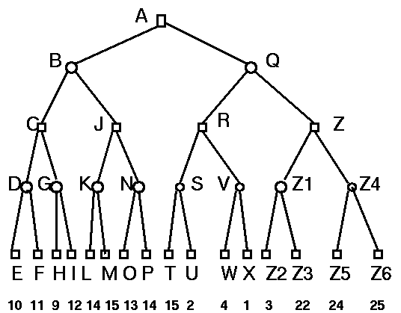
A: α = -inf, β = inf
B: α = -inf, β = inf
C: α = -inf, β = inf
D: α = -inf, β = inf
E: α = 10, β = 10 utility = 10
Originally from http://yoda.cis.temple.edu:8080/UGAIWWW/lectures95/search/alpha-beta.html

Slide 41
A: α = -inf, β = inf
B: α = -inf, β = inf
C: α = -inf, β = inf
D: α = -inf, β = 10
E: α = 10, β = 10
Originally from http://yoda.cis.temple.edu:8080/UGAIWWW/lectures95/search/alpha-beta.html

Slide 42
A: α = -inf, β = inf
B: α = -inf, β = inf
C: α = -inf, β = inf
D: α = -inf, β = 10
F: α = 11, β = 11
Originally from http://yoda.cis.temple.edu:8080/UGAIWWW/lectures95/search/alpha-beta.html

Slide 43
A: α = -inf, β = inf
B: α = -inf, β = inf
C: α = -inf, β = inf
D: α = -inf, β = 10 utility = 10
F: α = 11, β = 11
utility = 11
Originally from http://yoda.cis.temple.edu:8080/UGAIWWW/lectures95/search/alpha-beta.html

Slide 44
A: α = -inf, β = inf
B: α = -inf, β = inf
C: α = 10, β = inf
D: α = -inf, β = 10 utility = 10
Originally from http://yoda.cis.temple.edu:8080/UGAIWWW/lectures95/search/alpha-beta.html

Slide 45
A: α = -inf, β = inf
B: α = -inf, β = inf
C: α = 10, β = inf
G: α = 10, β = inf
Originally from http://yoda.cis.temple.edu:8080/UGAIWWW/lectures95/search/alpha-beta.html

Slide 46
A: α = -inf, β = inf
B: α = -inf, β = inf
C: α = 10, β = inf
G: α = 10, β = inf
H: α = 9, β = 9
utility = 9
Originally from http://yoda.cis.temple.edu:8080/UGAIWWW/lectures95/search/alpha-beta.html

Slide 47
A: α = -inf, β = inf
B: α = -inf, β = inf
C: α = 10, β = inf
G: α = 10, β = 9
utility = ?
H: α = 9, β = 9
At an opponent node, with α > β : Stop here and backtrack (never visit I)
Originally from http://yoda.cis.temple.edu:8080/UGAIWWW/lectures95/search/alpha-beta.html

Slide 48
A: α = -inf, β = inf
B: α = -inf, β = inf
C: α = 10, β = inf
utility = 10
G: α = 10, β = 9
utility = ?
Originally from http://yoda.cis.temple.edu:8080/UGAIWWW/lectures95/search/alpha-beta.html

Slide 49
A: α = -inf, β = inf
B: α = -inf, β = 10
C: α = 10, β = inf
utility = 10
Originally from http://yoda.cis.temple.edu:8080/UGAIWWW/lectures95/search/alpha-beta.html

